Slide 1


Wireless Network Testing
8/28/2015 LowRes
For Internal Purposes Only

Slide 2
OVERVIEW
BACKGROUND
Delphian Systems has developed SecuRemote as an integrated wireless communications system for OEMs who need a wireless mesh network with Bluetooth Low Energy communications. Version 1.0 of this network can support 255 devices (AC powered or Battery powered) over large areas (i.e. 350,000 sq.ft.).
PURPOSE
The purpose of this document is to lay out the requirements for a performance test of the SR wireless network in three JVA holdings facilities. Specifically, West-Tech Automation, Belwith Products, and Kennedy Manufacturing.
WIRELESS NETWORK TESTING
The SR wireless mesh network testing involves setting up to 255 SR devices inside each facility and testing for proper setup, connectivity, reliability, operational response/latency, and range given obstructions typical in work environments.
WORK ENVIRONMENTS
The selected facilities represent a mix of typical industrial work environments as described in the following pages.
TESTING PROCEDURE – PROTOCOL
The testing procedure involves placing 245 devices in designated places through the facility. The devices are inside a small enclosure with a battery pack or power adapter and they can just be placed on any flat surface or on vertical surfaces with Velcro (see photo). Each device enclosure is numbered. Before the placement the locations are identified in terms of zones inside the facility within the following guidelines:
Each zone represents a work area with a typical profile of walls and obstructions (equipment, racking, etc.).
Placement locations are spaced in a) as uniform of a manner as possible, b) in front and behind radio wave obstructions (i.e. equipment).
Placement is done in two or three height levels (typically floor level, table level, and close to the ceiling level on columns or walls).
Zoning and placement locations are planned based on the facility building drawing and facility photos as part of advanced planning.
Testing the range distance outside the facility walls.
Upon placement of the devices the network will be tested by running a special program from a laptop that simulates network activity (user message volume over the course of 1-2 hours per planned run. 2-3 repetitions “runs” will be scheduled to test alternative placements if necessary. The scheduling of this testing will be coordinated with the facility manager or designated individual (see planning requirements).
PLANNING REQUIREMENTS
The test will not disrupt the business and will be conducted over the course of a day or two. The actual placement can be performed before or after business hours. The 1-2 day visit will be planned ahead of time jointly with the management of the business. The Delphian team will be comprised of 3 employees. In addition, a designated individual from the business site is requested to help provide scheduling coordination, placement assistance, and in general to ensure there is no interference with work in progress.

Slide 3
Device Photos

Slide 4
CONTENTS
The information contained herein are provided for test planning purposes.
LOCATION AND BUILDING INFORMATION
Google maps with aerial photos of the buildings provide location context available line-of-site paths (parking lots, streets) for range testing purposes (inside of the building to outside distance available for range testing purposes).
General building information (area, # offices, column span, ceiling height, etc.).
BUILDING LAYOUT
Building layouts are provided from existing architectural drawings along with schematics that show the various work environment areas.
WORK ENVIRONMENT AREAS
The work environment areas are grouped in zones in order to provide context regarding the typical building areas and equipment related to workflow. Typical area zones are: Offices, In-plant offices and utility rooms (supervisory, QA, testing, WC, etc.), Shipping/Receiving docks and staging areas, Warehouse/Storage, Manufacturing (various operations such as fabrication, assembly, painting/coating, etc.).
INTERIOR SPACE OBSTRUCTIONS
The symbols below are used to describe the type and density of the various space obstructions in each zone. In order to assess the relative impact on the wireless range the obstruction level (Low, Medium, High) will be mapped against the location placement of all SR devices (Zone, Device #, Placement Height, Antenna Type, Location Description, Obstruction Level).
Low: Open space/isles, material staging/handling, tables and pallets with steel cabinets - avg. height < 5’.
Medium: Closed office walls, heavy presses and fabrication equipment – avg. height 6’ – 10’.
High: Steel racking with dense metal parts, equipment, walls with dense wiring, mezzanines, ductwork, etc. avg. height 10’ – 20’+
AREA PHOTOS
Photos representative of the described areas.
LOW
MED.
HIGH

Slide 5
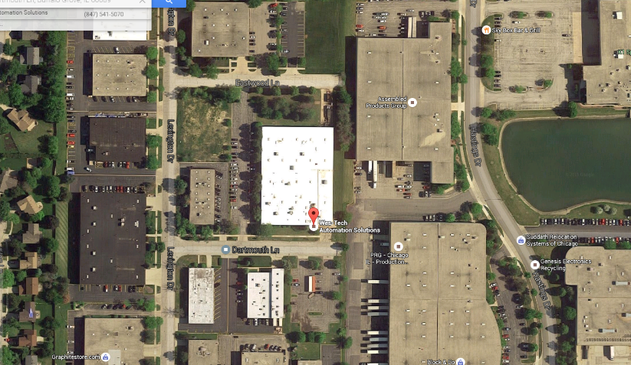
WES-TECH AUTOMATION
720 Dartmouth Ln. Buffalo Grove, IL 60089

Slide 6
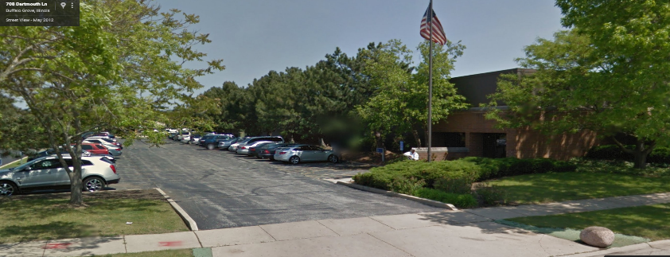
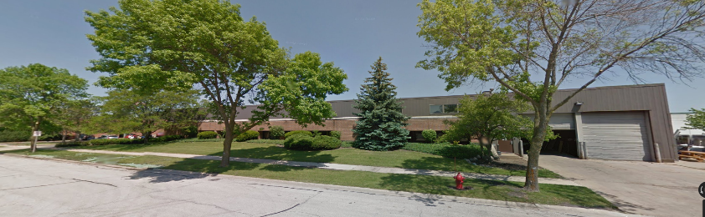
West side parking lot

Slide 7
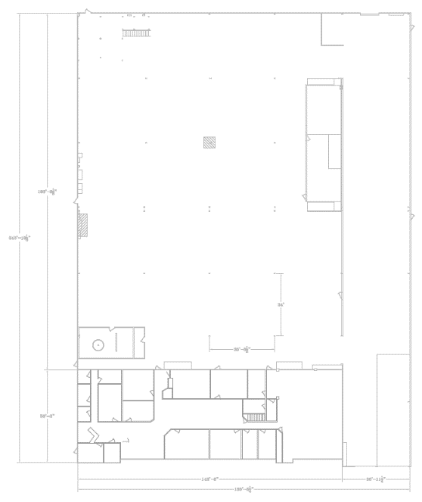
HIGH
WESTECH AUTOMATION
Custom automation machine engineering designer and builder of manufacturing assembly and test automation equipment and machinery.
www.wes-tech.com
LOCATION
720 Dartmouth Ln.
Buffalo Grove, IL 60089
BUILDING DESCRIPTION
Industrial building in commercial and light industrial park in Buffalo Grove Illinois.
45,000 sq.ft. building – steel construction
15,000 sq.ft. total office space
Total area including 2nd floor office area: 52,000 sq.ft.
30 office/conf. rooms in two floors
Multiple office cubicle areas
Incoming area with heavy steel racking and machining equipment and testing
Open machine building area with
Mezzanine areas as indicated
Column span 34’X 35’
Steel roof – height 23’
Typical wall construction
HIGH
Mezzanine Offices
Offices with Mezzanine
LOW
LOW
HIGH
HIGH
193’
Machine Building Area
243’
LOW
LOW
Incoming Mtl, QC, Machining Steel Racks
HIGH
HIGH
Column Span (typ)
34’
WCs
35’ - 6’
MED.
50’
Office Area
143’
180’
36’ - 11’

Slide 8
N
SR DEVICE LOCATIONS
The SR devices will be placed in as much of a uniform manner in the designated locations shown in the table below.
The number of total devices will very for each testing plan as shown in the table below.
C
D
Mezzanine Offices
Offices with Mezzanine
H
E
B
Machine Building Area
G
Incoming Mtl, QC, Machining Steel Racks
F
Column Span (typ)
34’
WCs
I
35’ - 6’
A1
A2
Office Area
BELWITH BUILDING LAYOUT

Slide 9
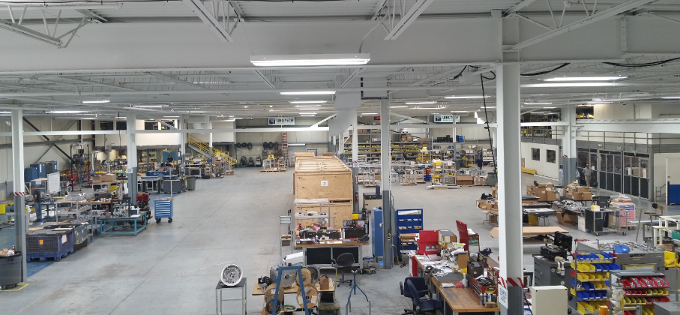
Machine Building Area
North View
C
B
D
E

Slide 10
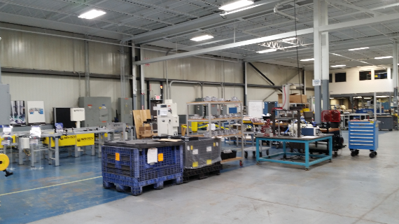
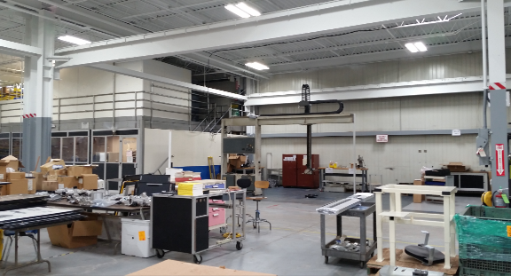
West wall (B)
South West wall with office mezzanine (C)
Middle offices and mezzanine (E)
Middle west wall (F)
B
C
E
F

Slide 11
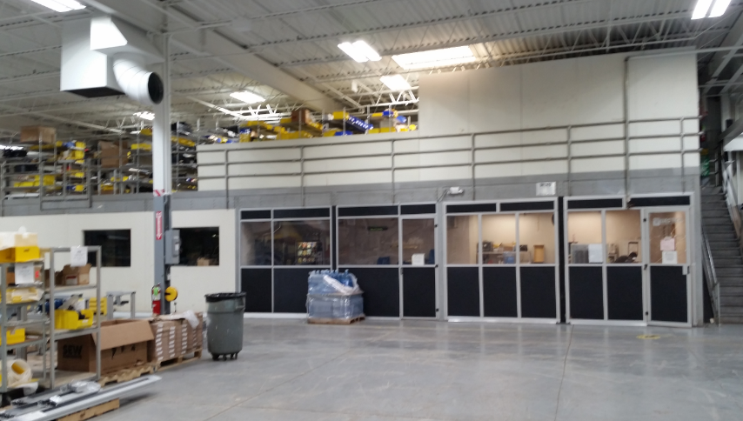
Middle offices and mezzanine (E)
E

Slide 12
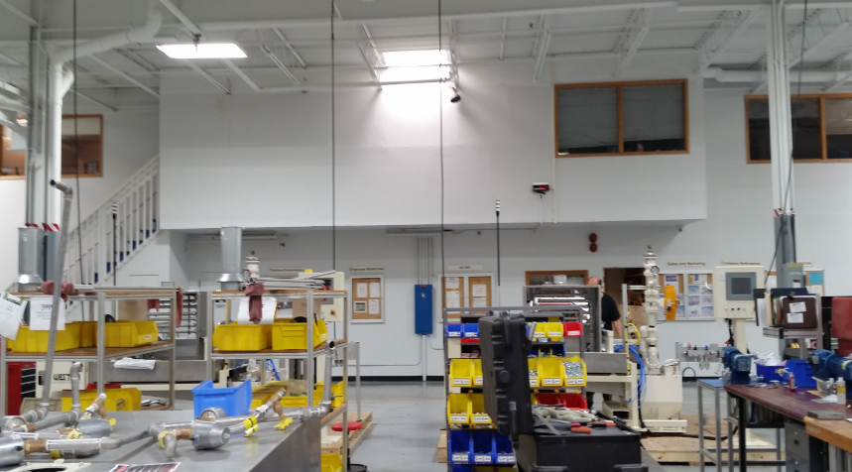
South interior view of the office walls that separate the fabrication area from the offices.
Ground floor offices wall (A1)
Second floor offices wall (A2)
A2
A1

Slide 13
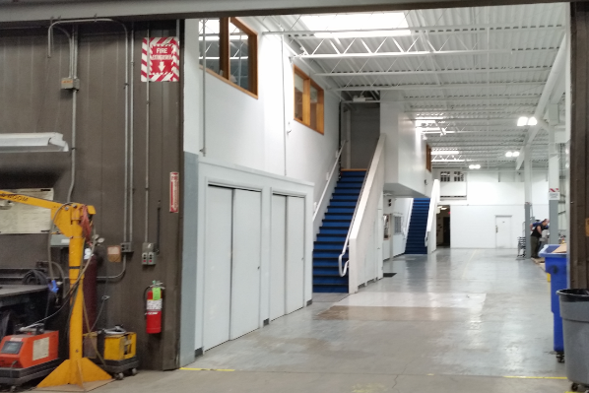
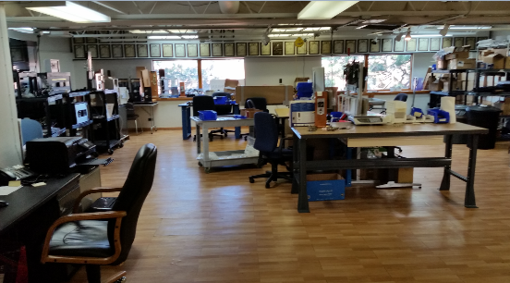
View of the interior office walls from the incoming interior dock on the south side of the building.
Second floor offices wall (A2) – View of laboratory area.
A2
A2

Slide 14
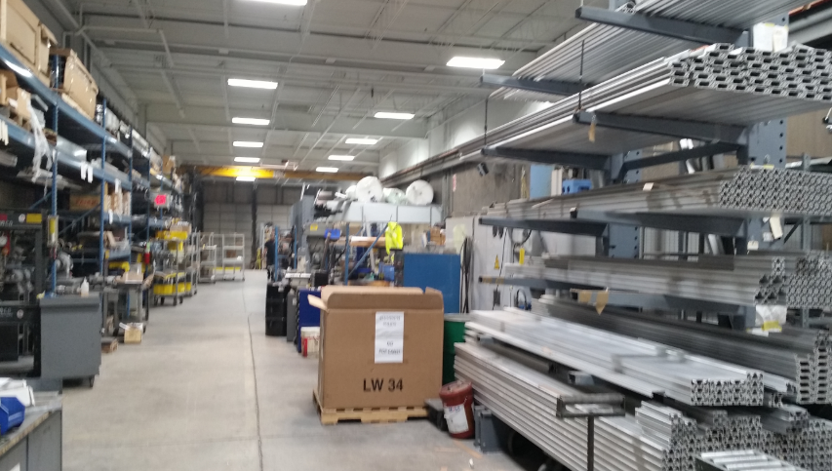
Material storage area – Metal racking, small equipment and parts
North View
H

Slide 15
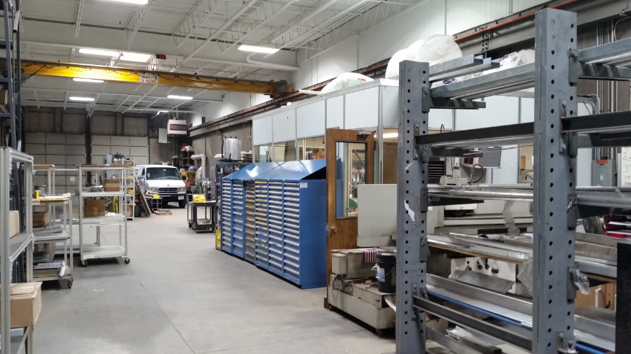
Incoming material dock– Modular metal cabinets, QC Lab,
South View
I

Slide 16
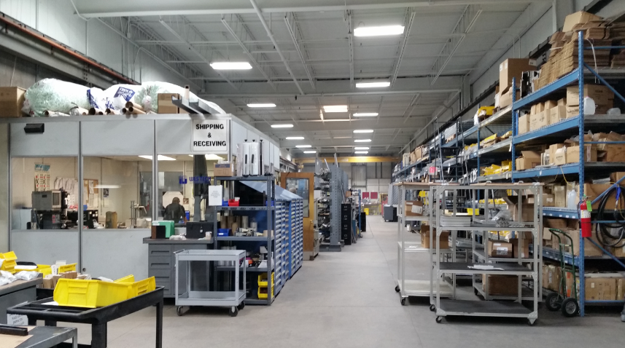
Incoming material dock
North View
I

Slide 17
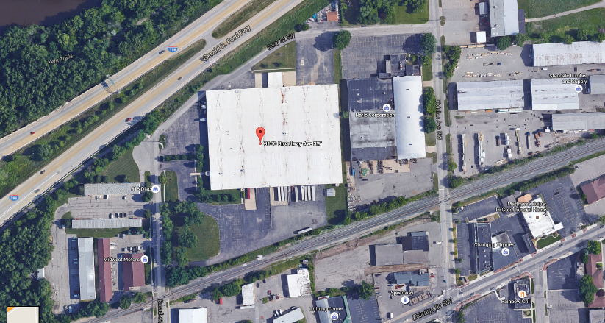
BELWITH PRODUCTS
3100 Broadway Ave SW, Grandville, MI 49418

Slide 18
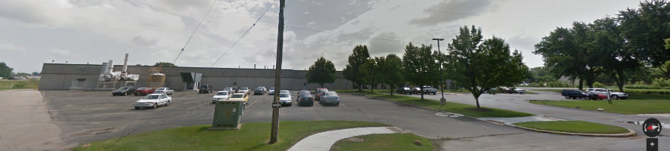
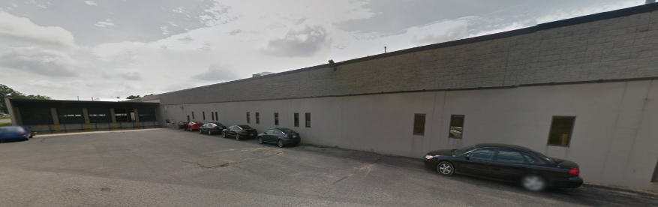
North West side parking lot

Slide 19
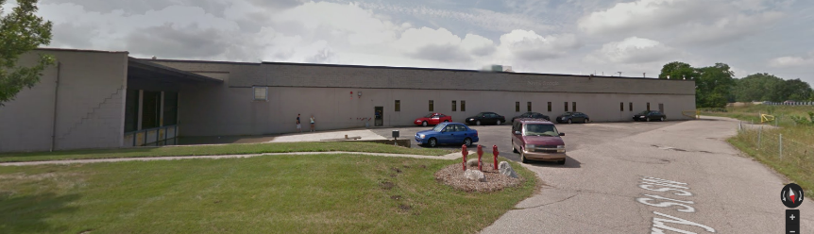
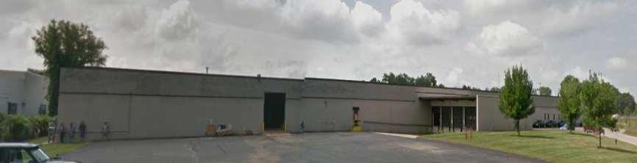
North East side parking lot

Slide 20
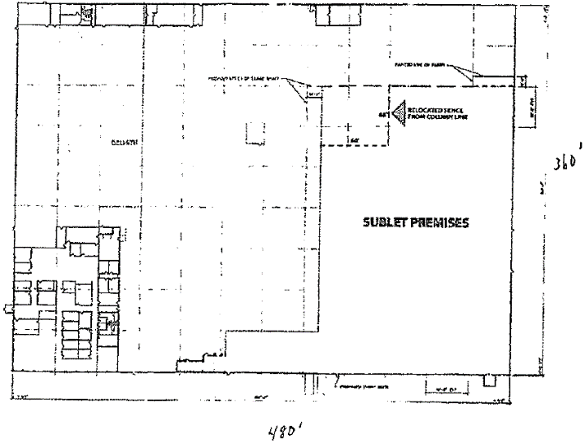
BELWITH PRODUCTS
Belwith and its Keeler division is a designer and manufacturer of cabinet and furniture decorative hardware, architectural hardware, and security hardware.
www.belwith.com
www.hickoryhardware.com
www.keelerproducts.com
N
HIGH
A3
A4
Indoor Truck Docks
D2
LOCATION
3100 Broadway Ave SW, Grandville, MI 49418
BUILDING DESCRIPTION
Industrial building in commercial and light industrial park in the Grandville township within close proximity to Grand Rapids.
High variety of work environment areas.
225,000 sq.ft. building
15,000 sq.ft. office area
157,000 sq.ft. warehouse and light assembly
53,000 sq.ft storage
30 office rooms
Multiple office cubicle areas
Incoming area with steel racking
Column span 40’ X 40’
Steel Roof – 20’ high
Typical wall construction – Block Wall
LOW
HIGH
HIGH
HIGH
B1
B2
Manufacturing Area
E2
E3
360’
MED.
LOW
HIGH
HIGH
MED.
HIGH
Warehousing
Area
A2
MED.
C1
HIGH
C2
HIGH
E1
E4
MED.
Storage
area
A1
LOW
LOW
MED.
Front offices
D1
Docking
Docking
480’

Slide 21
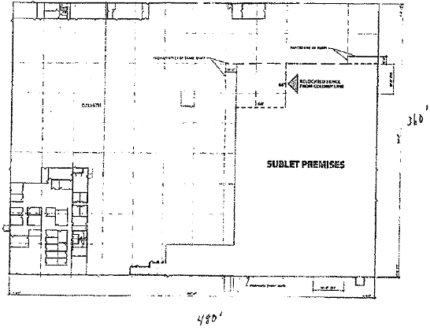
SR DEVICE LOCATIONS
The SR devices will be placed in as much of a uniform manner in the designated locations shown in the table below.
The number of total devices will very for each testing plan as shown in the table below.
N
BELWITH BUILDING LAYOUT
A3
A4
Indoor Truck Docks
D2
B1
B2
Manufacturing Area
E1
E2
360’
Warehousing
Area
Office Area
Storage
Area
A2
C1
C2
E3
E4
A1
Front offices
D1
Docking
Docking
480’

Slide 22
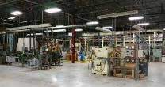
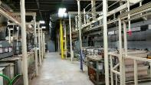
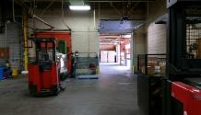

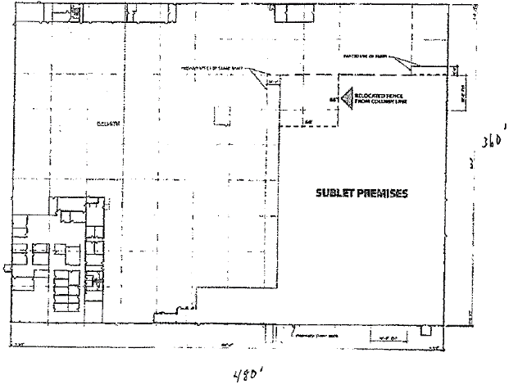
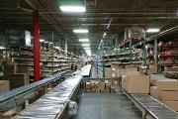

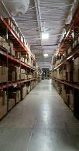


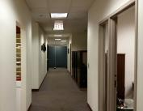
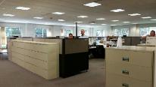
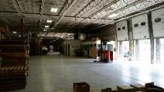
N
A3
A4
Indoor Truck Docks
D2
B1
B2
Manufacturing Area
E1
E2
360’
Office Area
Warehousing
Area
A2
C1
C2
E3
E4
Light Assy
Area
Storage
Area
A1
D1
Front Offices
Docking
Docking
480’

Slide 23


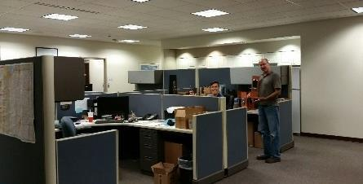
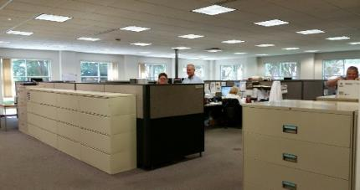
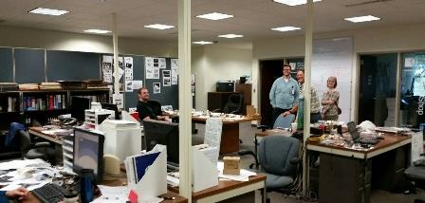
Front entrance and front office areas
A1
A2

Slide 24
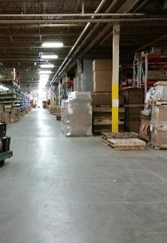
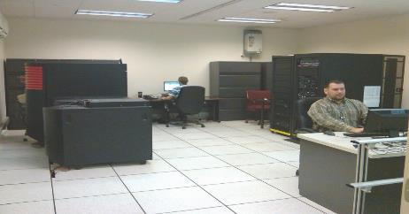
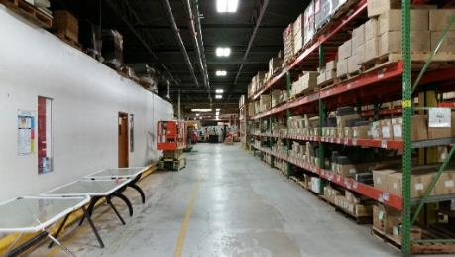
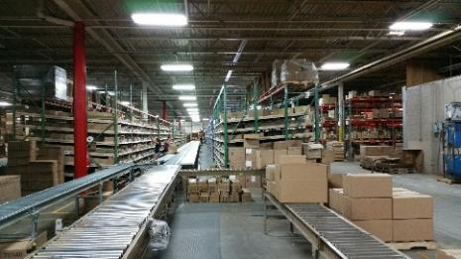
Computer room – (A2)
Picking/shipping line – (B2)
Lunch room – (A3)
Marketing showroom – (A3)
Warehouse racking – (B1)
A2
A3
B2
B1

Slide 25
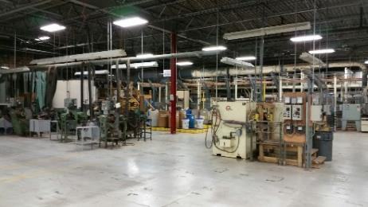
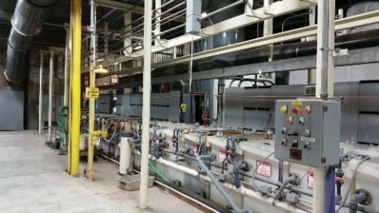
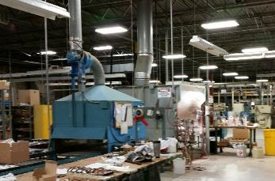
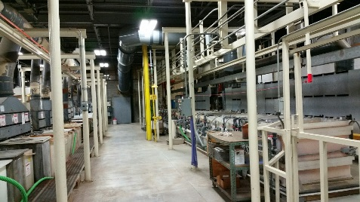
Manufacturing area with sand casting, spin casting, milling/machining.
Chemical processing lines for plating and finishing.
B1

Slide 26
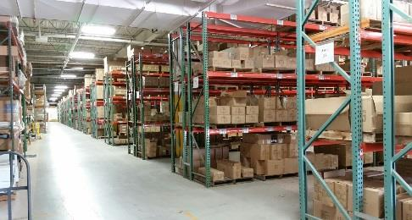
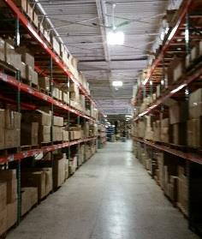
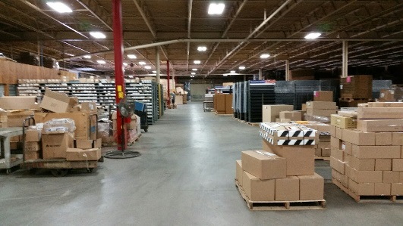
Warehousing – 3-high racking – (C2)
Storage area – (E1)/(E2)
C2
E1

Slide 27
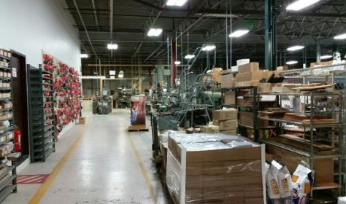
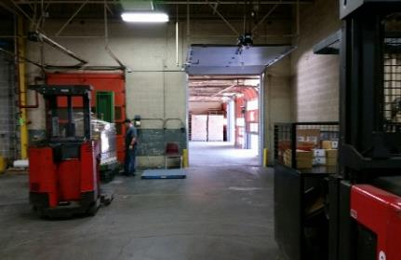
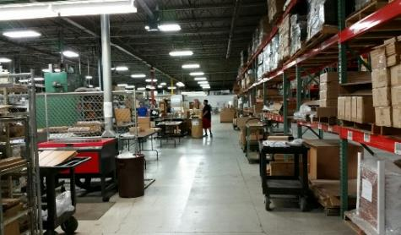
Office area separation wall – beginning of manufacturing area – (B1)
Light assembly area – (C1)
Indoor truck bay – (D2)
B1
D2
C1

Slide 28
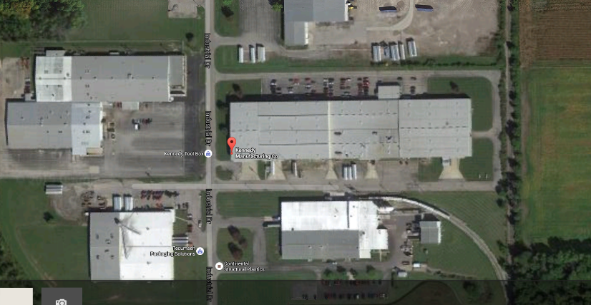
KENNEDY MANUFACTURING
1260 Industrial Drive, Van Wert, OH 45891

Slide 29
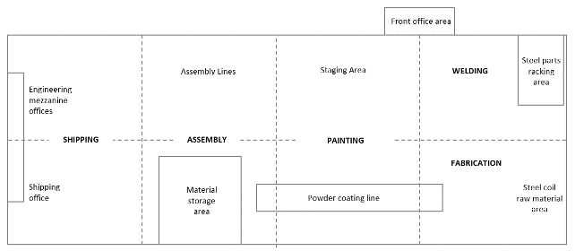
KENNEDY MANUFACTURING
Manufacturer of industrial tool storage systems, enclosures, roller cabinets and carts, modular cabinets, and related work benches and tool boxes for manufacturing companies.
www.kennedymfg.com
LOCATION
1260 Industrial Drive, Van Wert, OH 45891
BUILDING DESCRIPTION
Industrial building in commercial and light industrial park in Van Wert OH.
200,000 sq.ft. building
5,000 sq.ft. office area
175,000 sq.ft. warehouse and light assembly
18,000 sq.ft storage
28 office rooms
Multiple office cubicle areas
Incoming material area with steel racking
Column span 25’ X 40’
Steel Roof – 30’ high
Typical wall construction – Block Wall and Steel
PLANT LAYOUT
The factory is laid out in 8 primary functional areas (zones) as shown in the schematic below. Each zone has different characteristics in terms of space obstructions as noted.
Manufacturing Flow
MED.
HIGH
MED.
LOW
MED.
HIGH
LOW
LOW
HIGH
HIGH
MED.
LOW
SPACE OBSTRUCTIONS
Low: Material handling equipment, tables and pallets with steel cabinets - avg. height < 5’.
Medium: Heavy presses and fabrication equipment – avg. height 6’ – 10’.
High: Steel racking with dense metal parts, equipment, walls with dense wiring, mezzanines, ductwork, etc. avg. height 10’ – 20’+
MED.
HIGH

Slide 30
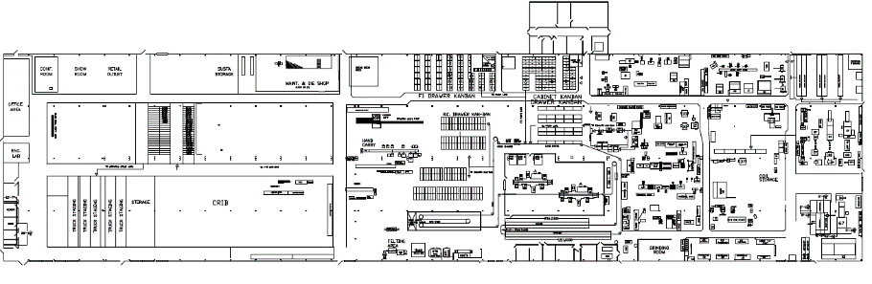
SR DEVICE LOCATIONS
The SR devices will be placed in as much of a uniform manner in the designated locations shown in the adjacent table.
The number of total devices will very for each testing plan as shown in the table.
Details of the east side and the west side of the plant are shown separately in the subsequent pages.
West Side
East Side
A1
ASSEMBLY
WELDING
E1
D1
C1
B1
A2
D1
D2
C2
B2
E2
D2
SHIPPING
Parts Storage Area
ASSEMBLY
PAINTING
FABRICATION

Slide 31

WEST SIDE
West Side
HIGH
HIGH
HIGH
MED.
MED.
MED.
HIGH
LOW
MED.
MED.
MED.
HIGH
LOW
HIGH
HIGH

Slide 32

EAST SIDE
MED.
MED.
MED.
MED.
MED.
HIGH
LOW
LOW
MED.
MED.
MED.
MED.
HIGH
MED.
LOW
LOW
HIGH
HIGH
HIGH
HIGH
HIGH
HIGH
MED.

Slide 33



Office entrance area and north side of the building
A1

Slide 34


A2
West side of the plant – 2-levels of in-plant offices.
Shipping offices with storage and HVAC equipment mezzanine above.
A2

Slide 35


Incoming material inspection and coil storage area.
B1
B2

Slide 36


Staging area for metal enclosures.
C1
Interior view of the painting room with powder coating line and 3 booths.
C2

Slide 37


Wide isle between high storage racking and crib area.
D1
Fabrication area.
D2

Slide 38


Shipping area with outbound elevated docks.
E2
South side of the building - inbound shipping elevated docks.
B1
B2

Slide 39


Metal parts racking area.
C1
Fabrication area.
B1

Slide 40
1. Wireless Testing Protocol – Detailed Description
Insert here….

Slide 41

SR Wireless Network Testing
Sample Test Architecture
Test Set-up
All the device connected to Coordinator can configure via PC Simulator.
By default all the SR device came with Router configuration built in.
By default maximum 40 number of Router can connect to Coordinator directly.
When mention number of Router devices added in Coordinator device, Coordinator will not allow more devices as a Router.
When user power on all the devices only first 40 Router device can connect with Coordinator directly and rest of the devices will connect as an END device.
User needs to configure connected Router device as an END device to allow rest of Router device connect with Coordinator directly in first layer.
Latency Terms
TCR :- Time between Coordinator to Router
TRE :- Time between Router to END device
TER :- Time between END device to Router
TRC :- Time between Router to Coordinator
Network Diagram

Slide 42
SR Wireless Network Testing Definition(s) and Abbreviation(s)
Configurable parameters for SR devices
Network id:
Network id is the same for entire ANT network form under one Coordinator.
User can create multiple networks by selecting their network id different.
Device Role:
There are mainly three different roles.
Coordinator
Router
END device
Power source:
There are two type of power supply.
Mains power operated devices
Battery operated devices
Router can only mains power supply.
End device can configure as battery operated device.
# Of Node:
User can control number of node value in network. Maximum 240 number of node can create under one network. When desired number of device add in Coordinator then it will not allow to add more device in network.
Note: - This option available only for Coordinator device.
# Of Router:
Using this option user can manage number of router that can directly connect with Coordinator. When maximum number of router adds in coordinator then other device cannot connect with coordinator directly.
By default its 40 number of Router can add in coordinator.
Note: - This option available only for Coordinator device.

Slide 43
SR Wireless Network Testing Definition(s) and Abbreviation(s)
Configurable parameters for SR devices
Internal Operation Time:
Its device actual operation time. By default its 1 second. User can configure internal operation time according to device actual operating time.
Retry Interval time:
Its interval time between two attempts which can configurable according to channel selection.
For fast channel its 1= 53 mille seconds
For slow channel its 1= 250 mille seconds
Cut-off RSSI:
User can set RSSI for each device to connect with their parent device.
By set cut-off RSSI user can control device range of communication with other devices.
Transmit Power:
Transmit power can be set at desired value by default its 10 dBM for all the devices.
For SRU233 user need to set power level to +4 dBM.
Antenna Type:
User can select type of antenna to communicate with other device.
There are two types of antennas.
Chip Antenna
u.FL Antenna

Slide 44

A) Create different zone in test site. Wes-tech has defined different zone in below figure
SR Wireless Network Testing
Step#1 SR Components Installation

Slide 45
B) Allocate Zone wise SR Devices plan A for WES-TECH AUTOMATION
SR Wireless Network Testing
Step#1 SR Components Installation (Cont..)
Zone | Area Name | Plan A | Coordinator | Router | END Device
A1 | Office Ground | 15 |  | 1 | 14
A2 | Office 2nd floor | 15 |  | 1 | 14
B | West wall | 5 |  | 1 | 4
C | SW Corner-Offices | 2 |  | 1 | 1
D | North wall | 5 |  | 1 | 4
E | Floor Offices with mezzanine | 3 |  | 1 | 2
F | Assy area-1 | 5 |  | 1 | 4
G | Assy area-2 | 20 | 1 | 1 | 18
H | Raw Material Racking | 5 |  | 1 | 4
I | Receiving Area | 5 |  | 1 | 4
Total |  | 80 | 1 | 10 | 69

Slide 46

C) Install SR Device as per Step#1.A and 1.B planning
SR Wireless Network Testing
Step#1 SR Components Installation (Cont..)

Slide 47

D) Factory Reset Switch
SR Wireless Network Testing
Step#1 SR Components Installation (Cont..)

Slide 48
E) LED Indication for SR Device
SR Wireless Network Testing
Step#1 SR Components Installation (Cont..)
SR # | Description | RED | GREEN | ORANGE | BLUE | Comments
1 | Power On |  | Solid |  |  | Solid until cut off power
2 | Advertisement |  |  |  | Blink every 5sec
3 | Connection |  |  |  | Solid | Solid until connection timeout
4 | Searching for ANT network |  |  | Blink every 5 sec
5 | Connected in ANT Mode |  |  | Solid |  | Solid until ANT connection timeout
6 | ANT Communication(verification of ANT operation) | Test LED on/off |  |  |  | User can control RED LED using PC simulator tool.

Slide 49
SR Wireless Network Testing Step 2 Network View Option
SR Network Simulator is desktop application and it will configure SR Devices on UART serial interface.
Connect Coordinator device to SR Simulator Tool via serial port.
Set the Baud Rate value 115200.
Start SR Network Simulator and select Com port and click on “Play”.
All the device connected to Coordinator will display in SR Network Simulator view screen.
All the devices connected to Coordinator can configure via SR Network Simulator.
It will help to configure ANT network. It will help to understand the current network formation.
Select “View” option from menu. There are two ways to view ANT network
Tree View
Tabular View

Slide 50

SR Wireless Network Testing Step 2 Network View Option (Cont.…)
A) Tree View
In tree view user can monitor and configure ANT network via Coordinator. In this screen user can view both “Connected Devices” and “Disconnected Devices” list. Coordinator device will display on top. All first layer devices will connected directly via line. Second layer devices will display connected to their parent’s devices.

Slide 51

SR Wireless Network Testing Step 2 Network View Option (Cont.…)
B) Tabular View
Tabular view will display all the devices information with detail mention below.
Device role, Device
Serial number
ANT Serial number
Parent’s device serial number
Location information.

Slide 52

SR Wireless Network Testing Step#3 SR Configure Coordinator Device
Connect Coordinator device to SR Simulator Tool via serial port. Start SR Network Simulator and select Com port and click on “Play”.
All the device connected to Coordinator can configure via SR Network Simulator.
“Right click” on Coordinator device and it will prompt “Configuration Settings” window.
To get current device configuration click on “Get Device Configuration” button and all the default parameter will display.
ANT serial number is unique for all the devices and not editable.
User can enter desired value in “Configurable Parameters” and click on “Set Device Configuration” button to save it for devices.
To set all the parameter value as per factory click on “Set Factory Default” button.
To return to previous screen click on “Close” option.

Slide 53
SR Wireless Network Testing Step#3 Configure Coordinator Device (Cont..)
For executing plan A user need to sets Coordinator device parameter value as mention in below table.
Network ID | 1
Device Role | ANT Coordinator
Power Source | Mains Operated
# of Node | 240
# of Router | 10
Internal Operation Time | 1
Fast Channel | 1
Slow Channel | 2
Cut off RSSI | -90
Default Transmitting Power | -12
Antenna Type | Chip

Slide 54

SR Wireless Network Testing Step#4 SR Configure Router Device
To configure Router device follow the steps mention below
Select Router device and right click on it and it will prompt “Configuration Settings” window.
To get current device configuration click on “Get Device Configuration” button and all the default parameter will display.
ANT serial number is unique for all the devices and not editable.
User can enter desired value in “Configurable Parameters” and click on “Set Device Configuration” button to save it for devices.
To set all the parameter value as per factory click on “Set Factory Default” button.
To return to previous screen click on “Close” option.

Slide 55
SR Wireless Network Testing Step#4 SR Configure Router Device (Cont..)
For executing plan A user need to sets Router device parameter value as mention in below table.
Network ID | 1
Device Role | ANT Router
Power Source | Mains Operated
Internal Operation Time | 1
Fast Channel | 1
Slow Channel | 2
Cut off RSSI | -90
Default Transmitting Power | -12
Antenna Type | Chip

Slide 56

SR Wireless Network Testing Step#5 SR Configure END Device
To configure END device follow the steps mention below
Select END device and right click on it and it will prompt “Configuration Settings” window.
To get current device configuration click on “Get Device Configuration” button and all the default parameter will display.
ANT serial number is unique for all the devices and not editable.
User can enter desired value in “Configurable Parameters” and click on “Set Device Configuration” button to save it for devices.
To set all the parameter value as per factory click on “Set Factory Default” button.
To return to previous screen click on “Close” option.

Slide 57
SR Wireless Network Testing Step#5 Configure END Device (Cont..)
For executing plan A user need to sets END device parameter value as mention in below table.
Network ID | 1
Device Role | ANT END Device
Power Source | Battery Operated
Internal Operation Time | 1
Fast Channel | 1
Slow Channel | 2
Cut off RSSI | -90
Default Transmitting Power | -12
Antenna Type | Chip

Slide 58

SR Wireless Network Testing Step#6 Configure Multiple SR Device
All the device connected to Coordinator can configure via PC Simulator.
User can configure SR device individually and set their desired parameters.
Click on “Configure Selected Devices”.
User can also select multiple device and configure all together.
User can also view all the device current configuration in one window. Please refer Figure 4: All Device Configuration

Slide 59

SR Wireless Network Testing Step#7 ANT Network Test
There are two types to types of test perform on ANT network. User can select desired type of test from “Test” option from toolbar.
Full Duplex Communication Test
Sensor Event Test

Slide 60

SR Wireless Network Testing Step#7 ANT Network Test (Cont.…)
A) Full Duplex Communication Test In this test user can perform one or multiple number of operation for one or more device and observe the operation success ratio and latency time.
User need to select devices from list of devices display in tree view.
Now need to enter number of operation that user want to perform.
Enter “Test ID” and “Test Engineer” name and click on “Test Start” button.

Slide 61
SR Wireless Network Testing Step#7 ANT Network Test (Cont.…)
B) Full Duplex Communication Test Example
In # Of Operations
Number of operation request for single or multiple devices can generate from PC simulator.
Operation delay time
User can configure time interval between two back-to-back operations.
Target Device Serial #
User can generate operation request for any device added with coordinator by entering device serial number.
Multiple Device selection
More than one device can select and send operation request to the entire selected device.
Example: -
# Of operations-10
Operation delay time-5 seconds
Target device serial#- 00000001, 00000002
PC simulator will give operation request to device serial # 00000001 and 00000002 at every five seconds for 10 times.

Slide 62

SR Wireless Network Testing Step#7 ANT Network Test (Cont.…)
C) Sensor Event Test
By performing Sensor Event test user can measure for Asynchronies event reporting time. It is also called as Reverse latency.
User need to select devices from list of devices display in tree view.
Now enter “No of Async Events”, “Async Events Start Time” and “Delay time” between two events.
Enter “Test ID” and “Test Engineer” name and click on “Test Start” button.

Slide 63
SR Wireless Network Testing Step#7 ANT Network Test (Cont.…)
D) Sensor Event Test Example
# of Async Event
User can also enter desired number of Async events that device needs to generate.
Delay time between two Async Events
By using this option time duration between two Async events can configure.
Target Device Serial #
User can generate Async request for any device added with coordinator by entering device serial number.
Multiple Device selection
More than one device can select to generate Async events.
Example: -
# Of Async Event- 10
Delay time between two Async events- 5 seconds
Target device serial#- 00000001, 00000002
PC simulator will give command to device serial # 00000001 and 00000002 start generation of 10 number of Async events every 5 seconds.

Slide 64
SR Wireless Network Testing Step#8 Sample Test Report (Cont.…)
Summary Report
Detail Report
A) Summary Report
Summary of performed test can view in this report. It is helpful to find out ANT network reliability, RSSI and Latency. Report will display Test ID, Date, Test Engineer, and Device hardware and software version detail.
Summary report will include terms mention below
Serial Number
Date and Time
Device Serial Number
Type of Device
Parent Device’s Serial Number
Device Location
Device Layer
Average RSSI
Number of Operation
Data send at First attempt
Data send at second attempt
Data send at third attempt
Response Time out
Data Success Ratio
Minimum value of Latency
Average value of Latency
Maximum value of Latency
Please refer attached excel file “Sample Report” for sample of summary report excel sheet for detail.

Slide 65
SR Wireless Network Testing Step#8 Sample Test Report (Cont.…)
B) Detail Report
Detail report can create in PC Simulator for any device under ANT network.
Report will display Test ID, Date, Test Engineer, and Device hardware and software version detail.
Custom report is detail report of individual device which include terms mention below
Serial Number
Date and Time
Device Serial Number
Type of Device
Parent Device’s Serial Number
Device Location
Device Layer
RSSI
Number of Operation
Operation Status
Retry Count
Response Time out
TCR
TRE
TRE
TRC
Latency
Please refer attached excel file “Sample Report” for sample of Detail report excel sheet for detail.

Slide 66
SR Wireless Network Testing Step#8 Sample Test Report (Cont.…)
Sample Summary Report
Sample Detail Report
SR # | Date/Time | Device Serial # | Type of Device | Parent device Serial # | Device Location | Device Layer | Average RSSI | # of Operation | Data send at First attempt | Data send at Second attempt | Data send at Third attempt | Response Time out | Data Success Ratio | Latency
 |  |  |  |  |  |  |  |  |  |  |  |  |  | MIN | AVG | MAX
SR # | Date/Time | Device Serial # | Type of Device | Device Location | Device Layer | Parents device Serial # | RSSI | # of Operation | Operation Status | Retry Counter | Response Time out | Latency |  |  |  | Latency
 |  |  |  |  |  |  |  |  |  |  |  | TCR | TRE | TER | TRC

Slide 67

SR Wireless Network Testing Symbol Explanations
Reference(s)
Document No | Title
 | ANT Network-01.01.01
 | ANT Network Testing Tool Guide 01.01.01
 | ANT Latency Calculator

Slide 68
SR Wireless Network Testing Risk
In case of Battery powered device trade off will arise between Battery Life Vs Frequency of communication.
Latency will be observed to user in case of remote operation, if RELAY function of ANT protocol is required.
Assumption
We are using Burst mode of data transmission.
Power level of each node is +10 dBm.
Channel period for all Nodes is 4 Hz (250 ms).
Entire ANT network is operating at 2425 MHz.
SR Node can be AC powered or Battery powered.
All SR Nodes contains one Network status LED and one Push Button for user interaction.
Entire mesh network will work on Channel‐0 and Channel‐1 of an ANT Device.
All start networks formed in this must use SHARED channel communication. I.e. Channel‐0 and Channel‐1 must be configured as SHARED BIDIRECTIONAL COMMUNICATION channel in ANT network.
SR Node which is Battery powered can never acts as Router in ANT network and always works as END device.
SR Node which is AC powered can act as END device as well as Router.
SR Node, who is playing as Router, has channel‐0 configured as END device and channel‐1 configured as Router.
It has been assume that all SR Node must be in range of Coordinator (ANT), otherwise remote operation of that SR Node will not be feasible.

Slide 69
ATTACHMENTS
Ashok: Insert here the title of any sections you want to add now or later. For instance here is what I suggest:
Wireless Testing Protocol – Detailed Description
Connectivity – Range Measurements and Observations
Network Performance Results
Reliability
Latency

